Slide 1



Are
You
Planning for
2016
PQRS?
May
18, 2016 – 1-2 pm
MDT
Presented by:
Sarah Leake, MBA,CPEHR
HTS, a department of Mountain-Pacific
Quality Health Foundation
1

Slide 2




➢ Thank you for spending your valuable time with us
today!
➢ You can put questions in the chat box or wait for
open microphone time at the end.
➢ A link to both presentation slides and recording on
our website will be sent to attendees following the
webinar today.
➢ Your feedback is greatly appreciated and
provided via the post-webinar survey.
can
be
2

Slide 3

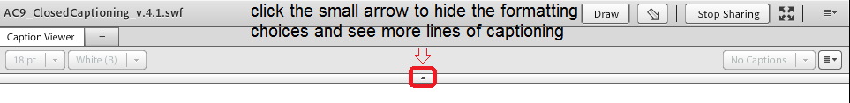
➢ Closed captioning will appear under today’s
presentation. To see
more lines
below.
of
captioned
text,
click
the
small
arrow
3

Slide 4
➢ Health Technology Services (HTS) is a department of
Mountain-Pacific Quality Health (MP).
MT/WY/AK/HI.
➢ We can help to:
M-P is the QIN/QIO for
◦
◦
Simplify and streamline quality reporting requirements
Stay current on changing regulations for Meaningful Use,
PQRS, MACRA, QPP etc.
Simplify HIPAA compliance
Advance and leverage your EHR usage to advance care
delivery
Enhance patient engagement and satisfaction
Improve health outcomes to maximize value based
performance payments
◦
◦
◦
◦
4

Slide 5

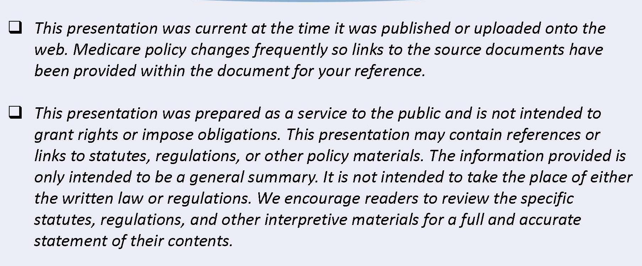
5

Slide 6


Sarah Leake
Sarah Leake, MBA, CPEHR
Health Technology and Quality Consultant
HTS, Mountain-Pacific Quality Health

Slide 7

➢
Understand the changes and requirements
2016 PQRS and Value Modifier Reporting
Review Group vs Individual Reporting
for
➢
➢
➢
➢
Key
The
Key
Considerations in PQRS Planning
Near Future
Tasks List and where you should be in
2016 PQRS reporting
This webinar will not be looking at the
various reporting mechanisms and details of
submitting PQRS Measures.
➢

Slide 8


Slide 9



➢ 2014
➢ 2015
➢ 2016
◦ Last
performance
performance
performance
year →
year →
year →
2016
2017
2018
payment
payment
payment
year
year
year
adjustment under current PQRS/VM
➢ Starting 2017 performance year → 2019
payment year…
◦ Payment adjustments for quality reporting and
other
factors will be made under MIPS, as required by
MACRA
Quality Payment Program

Slide 10

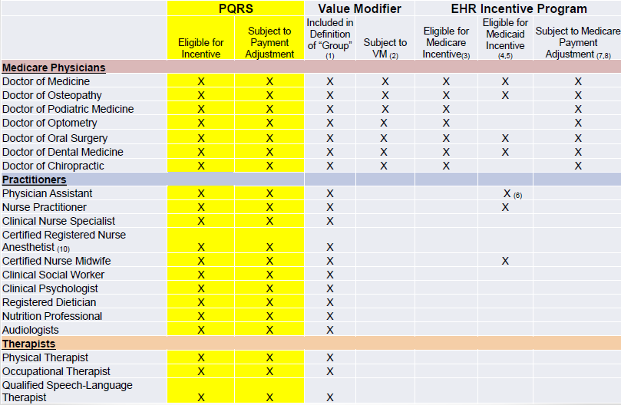
X X X
X
https://www.cms.gov/Medicare/Quality-Initiatives-
Patient-Assessment- Instruments/PQRS/Downloads/2016_PQRS_List_o f_EPs.pdf
10

Slide 11

➢
Determine if you bill Medicare Part B PFS. (CMS1500 or
CMS1450 at NPI Level).
Review Eligibility List (on previous slide)
https://www.cms.gov/Medicare/Quality-Initiatives-Patient-Assessment-
Instruments/PQRS/Downloads/2016_PQRS_List_of_EPs.pdf
Determine who is billed under your TIN
o Look at QRUR 2015 Mid Year Report. These are the providers that
CMS is considering eligible if they are listed and report measures.
CAH-II Reporting for PQRS - CMS has packaged several documents
➢
➢
➢
containing information that is relevant to Critical Access Hospitals (CAHs)
billing under Method II in relation to 2014, 2015, and 2016 PQRS.
Go to MLN Matters Link to Guidance on the Physician Quality
Reporting System https://www.cms.gov/Outreach-and-Education/Medicare-Learning-
Network-MLN/MLNMattersArticles/Downloads/SE1606.pdf
➢
11

Slide 12
Value Modifier Payment Adjustments
for Eligible Professionals in 2018
(Based
on
2016
Quality and Cost Data)
Groups with 2 to 9 EPs
and Solo Physicians
PAs, NPs, CNSs, CRNAs and physician groups with PAs, NPs, CNSs, CRNAs
Groups with 10+ EPs
groups with PAs, NPs, CNSs, CRNAs
PAs, NPs, CNSs, CRNAs and physician
Did not
participate in
2016 PQRS
Participated in
2016 PQRS (based on quality tiering)
Did not
participate in
2016 PQRS
Participated in
(based on quality
2016 PQRS
tiering)
- 2.0%
of Medicare Part B FFS
charges
- 2.0%
of Medicare Part B FFS
charges*
No adjustment
of Medicare Part B FFS
charges
Upward adjustment
of Medicare Part B FFS
charges
- 4.0%
of Medicare Part B FFS
charges
- 4.0%
of Medicare Part B FFS
charges*
No adjustment
of Medicare Part B FFS
charges
Upward adjustment
of Medicare Part B FFS
charges
VBM based on
VBM based on
*Groups with ONLY non-
Physician EPs WILL NOT
receive negative adjustment
performance with factor
of up to +2.0x%
performance with factor
of up to +4.0x%
NOTE: In addition to
PQRS 2% adjustment for not reporting successfully!

Slide 13

➢ Groups and solo practitioners subject to
upward, neutral or downward adjustments
derived under quality-tiering methodology
◦ Exception: Groups consisting of only nonphysician EPs and
solo practitioners who are nonphysician EPs held harmless
from downward adjustments under quality-tiering
methodology in CY 2018 unless they do not satisfactorily
report!
➢ VM waived if at least one EP billed for PFS items
and services under TIN during 2016 year in
Pioneer ACO Model, Comprehensive Primary
Care Initiative (CPCI) or other similar innovation
center models

Slide 14

➢ In 2016, 281 individual measures for PQRS; 23 cross-cutting
measures
➢ Added 3 new measures groups: Multiple Chronic Conditions;
Cardiovascular Prevention (Million Hearts); and Diabetic
Retinopathy (total of 25 Measure Groups)
➢ Adding the Qualified Clinical Data Registry (QCDR) reporting
option for GPRO in 2016
➢ 18 Measures for GPRO Web Interface (17 measures in 2015)

Slide 15

Reporting Methods for 2016
METHOD
Individual
Group
2-24
Group
25-99
Group 100+
Claims
X
Registry Individual Measures
X
X
X
X
Registry Measures Group
X
Certified EHR or Direct Submission
Vendor
X
X
X
X
Qualified Clinical Data Registry
(QCDR)
X
X
X
X
GPRO Web Interface
X
X
Certified CG CAHPS Survey Vendor
N/A
Optional
Optional
Mandatory

Slide 16

Criteria for 2015 Registry EHR
No of Measures 9 9
No of Domains
3
3
Exception to # ^{Yes, report those}
Medicare data
Measures & Domains
No
measures that
have
Subject to MAV
Yes
No
Cross Cutting Measure
Required
Yes
No
% of Medicare
Beneficiaries Required
Measures must
have at
Must have at least
one measure with
Medicare data
least 50% of Medicare
Part B FSS patients
Full Year Reporting Yes Yes
Satisfy Meaningful Use
No
*Yes

Slide 17

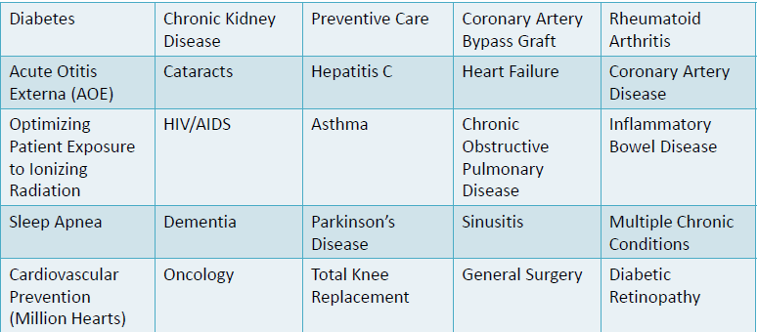
➢ A measure group is defined as a subset of 6 or more PQRS measures
that have a particular clinical condition or focus in common
➢ All applicable measures within the group must be reported for all
patients in the sample seen by the EP during the reporting period

Slide 18

➢ CMS collaboration with Specialty Societies on Measure Sets
➢ Measures accurately reflect a particular clinical area.
➢ Not required measures—a Guide to selection
➢ The following were established
in 2015:
1.
2.
3.
4.
5.
6.
Cardiology
Emergency Medicine
Gastroenterology
General Practice/Family
Internal Medicine
Multiple Chronic Conditions
7.
8.
9.
Obstetrics/Gynecology
Oncology/Hematology
Ophthalmology
10.
11.
12.
Pathology
Radiology
Surgery
➢ CMS is adding the following specialty measure sets in 2016:
1.
2.
3.
4.
5.
Dermatology
Physical Therapy/Occupational Therapy
Mental Health
Hospitalist
Urology

Slide 19
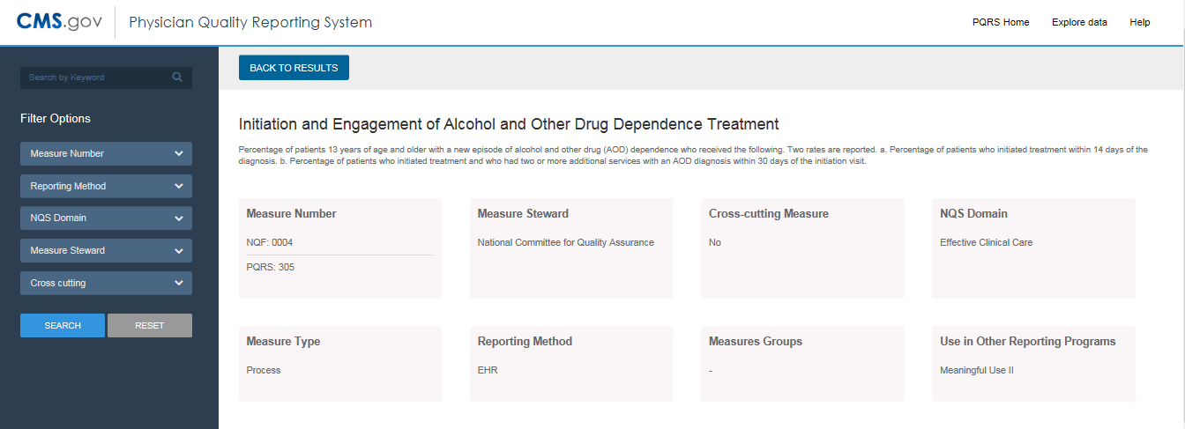
➢ New for 2016 PQRS: The "2016 PQRS Individual Measure
Specifications for Claims and Registry Reporting" can be
viewed on the PQRS Web-Based Measure Search Tool.

Slide 20


Slide 21

➢ What methods are available for Reporting out of
the EHR?
➢ Does Vendor support EHR Direct or Direct Vendor
Submission method?
➢ What measures are available for each Method?
➢ Do you have the specific software modules to
report PQRS measures in the QRDA Format?
➢ Can the EHR report the entire year of CQM Data?
Using the EHR for Reporting is Encouraged!

Slide 22


➢
Additional set of
measures defined
➢
Same set of measures,
but not all are available
to report electronically.
CMS defined data
elements
Use CEHRT to generate
CQM report, extract into
QRDA format and upload
by
CMS to measure quality.
Reported through
Meaningful Use
attestation.
Must use CEHRT to
generate CQM report and
submit data to CMS (CMS
defined data elements)
➢
➢
➢
➢
electronically
portal.
to
CMS
Clinical Quality Measure
Electronic Clinical Quality
Measure
eCQMs for eReporting for the 2016
Reporting Period

Slide 23

➢ Vendor Sites have helpful Information
◦ Steps for Reporting, Videos on Uploading Data
◦ Requirements specific to them
➢ Good Vendors are experienced at Registry
Reporting
◦ TIPS, Ask Questions, Interview them, Learn from them!
◦ HAVE a DEFINED Schedule – WATCH FOR THIS!
➢ Review Vendor on the 2016 PQRS Qualified
Registries List
◦
Does the Vendor report Measure Group, Individual
Measures or both?
Do they support GPRO?
What are ACTUAL services offered and Cost?
◦
◦

Slide 24





➢
Combining PQRS reporting with other
health care programs will reduce
administrative burden and help focus
quality initiative energy and resources






Million Hearts
Performance Improvement Network
National Diabetes Prevention Program
Centers for Disease Control and
Accountable Care Organizations
Prevention
Quality Improvement Organizations

Slide 25

➢
The Quality Resource Use Reports (QRURs) are a
tool for analysis as part of the CMS Physician
Quality and Value Based Program
Provides comparative information about the Quality
of Care and Cost of the Care delivered to
Physicians Medicare Fee-for-Service Patients
CMS will use the performance scores used in
calculating the value-based payment modifier
(VBM) to apply differential payment to a physician
or group of physicians under the Medicare
Physician Fee Schedule (PFS).
➢
➢
25

Slide 26

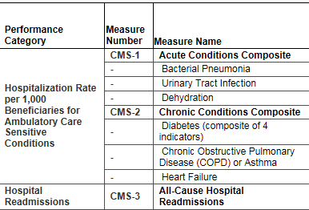
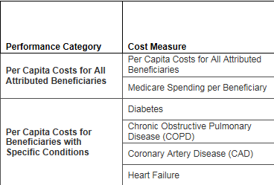
Quality
Cost
Look at these Conditions as Areas of Concentration
for PQRS:
Diabetes, COPD/Asthma, Heart Failure, CAD
Example from: Review of the 2014 Mid-
Year Quality and Resource Use Reports June 3, 2015, CMS Medicare Learning Network

Slide 27

➢ For information on the Mid-Year QRUR:
2015 QRUR and 2017 Value Modifier
➢ Access 2015 Mid-Year QRUR at CMS
Enterprise Portal using EIDM account with
correct role
➢ For information about obtaining Mid-Year
QRUR: How to Obtain a QRUR

Slide 28
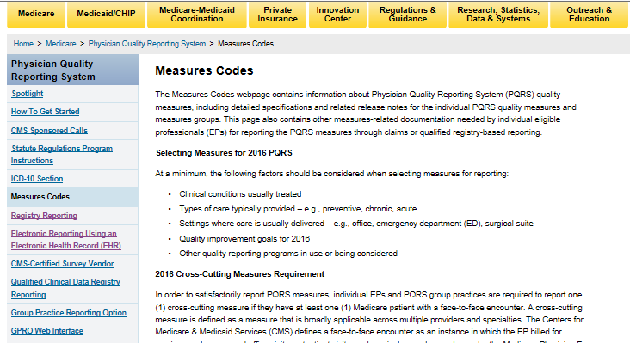
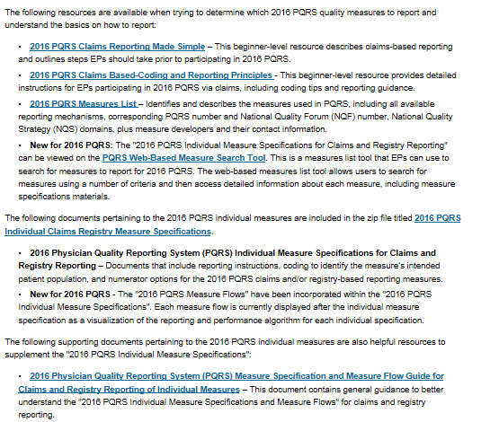
➢ Caution: Use the Measure Specifications for the Specific
Method of Reporting

Slide 29

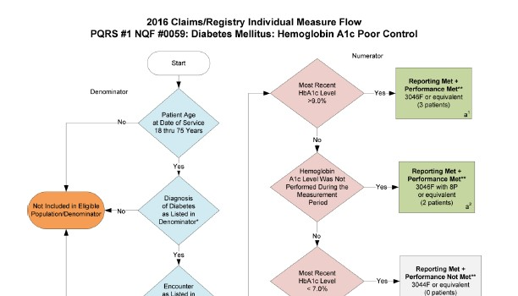
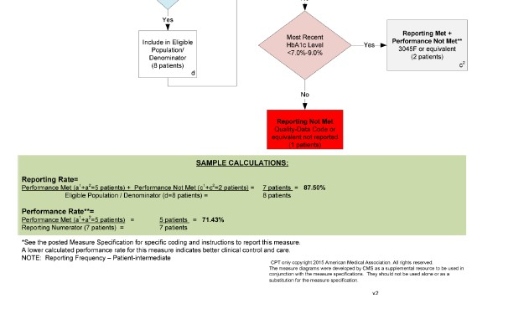
The Individual Measure Definitions are included in the
zip file titled 2016 PQRS Individual Claims Registry
Measure Specifications. This zip file also includes
individual claims/registry measure flow diagrams. The Measures Group Specifications are included in the zip file titled 2016 PQRS Measures Groups
Specifications Supporting Documents:

Slide 30
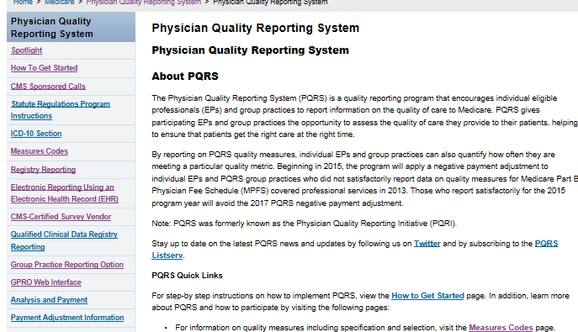
➢ 2016 Implementation Guide
Available: PQRS How To Get Started webpage
Information for individual EPs and PQRS group practices
participating in 2016 PQRS
➢ 2016 PQRS Measures Page
Available: Measure Specifications
Groups, Measure Sets
for Claims, Registry, and
Measures
2016 PQRS
information under each Tab

Slide 31


➢ Last day Claims are Processed-2/24/2017
➢ Qualified Clinical Data Registry (QRDA) –
2/28/2017
➢ EHR Direct Submission – 2/28/2017
➢ EHR Direct Submission Vendor – 2/28/2017
➢ Qualified Clinical Data Registry (XML) - 3/31/2017
➢ Registry – 3/31/2017
➢ Group Practice Reporting Option (GPRO) Web
Interface – First Quarter (exact dates pending)
http://www.cms.gov/Medicare/Quality-Initiatives-Patient-
Assessment-Instruments/PQRS/Downloads/2015-
17_CMS_PQRS_Timeline.pdf
31

Slide 32


Slide 33
➢ Registration now open and closes June 30, 2016
➢ Register using valid Enterprise Identity
Management (EIDM) account
➢ Groups of 2 or more EPs can participate in PQRS
using GPRO reporting methods
➢ You must register to use GPRO and indicate
submission method when you register
your




Qualified PQRS Registry
Direct EHR or via Data Submission Vendor
Web interface (groups of 25 or more only)
Qualified Clinical Data Registry
➢ 2016 PQRS GPRO Training Guide

Slide 34
➢
Successfully reporting will
cover all providers in Group
➢
Group practices must contract with
CMS-certified CAHPS Vendor and
bear survey admin costs (if 100+
group)
For groups of 2 or more providers
choosing to report individually,
50% of Providers must successfully
report PQRS to avoid VM
adjustment.
Must register as group by
6/30/2016 including Method
Measures may not be applicable to
all providers
TIN from PQRS
penalties
and
VM
➢
➢
Registry: Report 9
measures/3 domains and
not all providers need to be
represented in measures
Individual providers who
have difficulty with
reporting requirement for
individuals will be eligible
➢
➢
➢
◦
May Impact Public reporting
➢
Consider Provider Turnover
PROs
Important Items!!

Slide 35


Slide 36
➢ By NOW – Completed PQRS Planning and in
Implementation Phase
➢ Measure Selection and Monitoring
➢ Verify that you have Correct Roles and are
registered in EIDM
➢ June 30, 2016 – Register if reporting GPRO
◦
◦
Include Method for Reporting
Investigate and Choose CAHPS Survey Vendor
(check on their deadline to sign up)

Slide 37

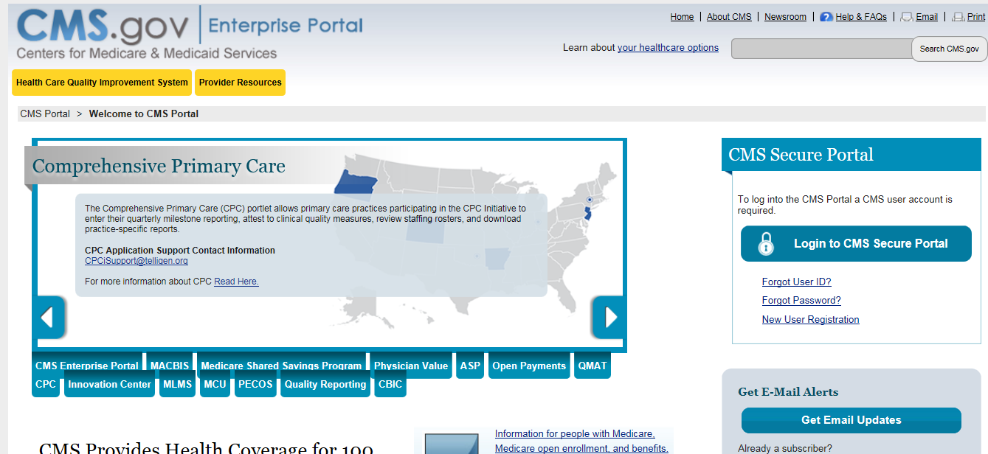

Slide 38

1.
2.
3.
4.
Will you be participating – Cost Analysis.
How will you participate?
What Method will you Report?
Who will be responsible from your
organization for this CMS program?
Plan for Training, Informing Staff, Education.
Define steps for Gathering Data / Validating
Data / Test Submission of Data.
Monitor Activity to Stay on Schedule and meet
Deadline.
5.
6.
7.
38

Slide 39

Step
Date
Complete
Tasks for Measure Selection
1
Understand requirements for measure reporting
# of measures, # of domains, cross cutting measures
2
Identify measures available for your reporting mechanism
3
Consider factors specific to your practice/clinic
Clinical Conditions, Types of Care, Settings of Care
4
Align with your other Quality Reporting initiatives and measures
5
Review QRUR report - Cost & Quality data
6
Identify measures for your Practice and Review
*Create your list with possible measures (crosswalk)
7
Assess the current baseline data
8
Identify Improvement Notation for each measure (high/low performance better)
9
Verify Medicare beneficiary requirements
10
Confirm Measures to Monitor
39

Slide 40


Slide 41
➢ Section 101(b)(1)(A) of MACRA amended section
1848(a)(7)(A) of the Act to sunset the meaningful
use payment adjustment for EPs at the end of CY
2018.
➢ Section 101(c) of MACRA added section 1848(q)
of the
Based
would
Act requiring the establishment of a Merit-
Incentive Payment System (MIPS), which
incorporate meaningful use.
*This information was released in the federal
register in Oct of 2015.

Slide 42




➢ Payment adjustments for the current Meaningful
Use program will continue until December 31,
2018, based on 2016 reporting.
➢ … at that point the current MU payment adjustment
program will “sunset” and be replaced by a new
Merit-based Incentive Payment System (MIPS),
which is being created under the new MACRA
(Medicare Access and CHIP Reauthorization Act)
law.
QUALITY PAYMENT PROGRAM
42

Slide 43

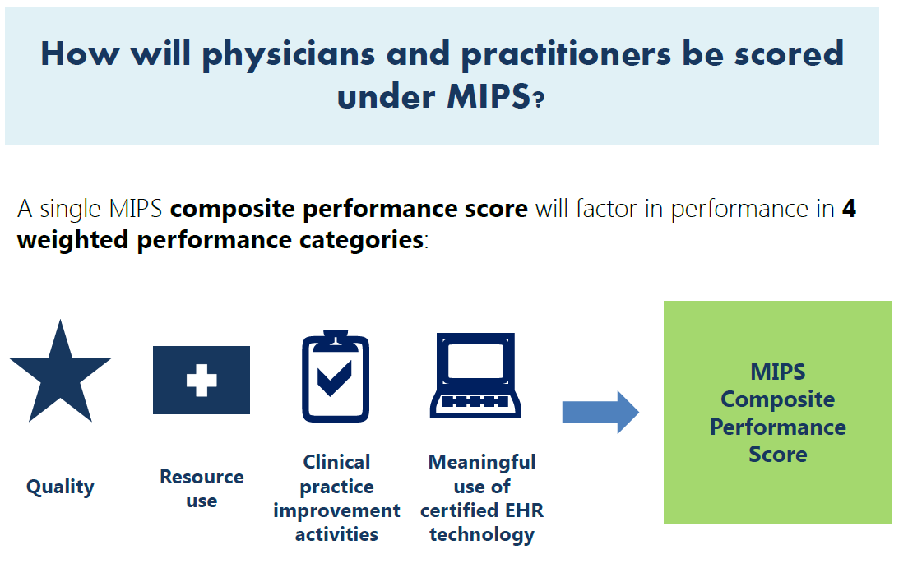
50%
10%
15%
25%
Advanced
Care
Information
https://www.cms.gov/Medicare/Quality-Initiatives-Patient-
Assessment-Instruments/Value-Based-Programs/MACRA-MIPS-and-
APMs/MACRA-MIPS-and-APMs.html

Slide 44

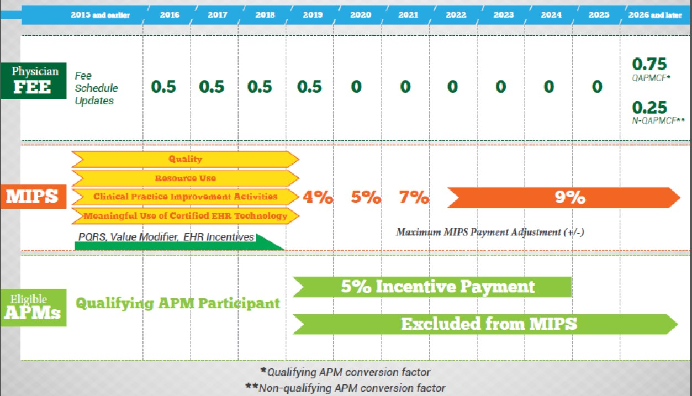
We will have a separate webinar to discuss
the details of
MACRA/MIPS
later
this
year.
https://www.cms.gov/Medicare/Quality-Initiatives-Patient-
Assessment-Instruments/Value-Based-Programs/MACRA-MIPS-and-
APMs/Timeline.PDF

Slide 45
Upcoming Webinars
➢
Wednesday, May 25, 2016
12:00-1:00 pm EST
MIPS: Advancing Care Information Overview
➢
Wednesday, June 15, 2016
12:00-1:00 pm EST
MIPS: Clinical Practice Improvement Activities (CPIA) Overview
➢
Friday, June 17, 2016
12:00-1:00 pm EST
MIPS Scoring Overview
➢
Wednesday, July 13, 2016
1:00-2:00 pm MDT
2016 Meaningful Use Mid Year Review
Past webinar about the MACRA:
➢ MACRA Request for Information: MIPS, APMs, PFPMs – 10/8/15
(register to watch the recorded
webinar)
MACRA and QPP Site Links
➢ CMS Site on Learning Opportunities for MACRA Proposed Rule
➢ Quality Payment Program CMS Site - Fact Sheet, Timeline, Past and Future Webinars, Slide Deck

Slide 46





Sarah Leake -
➢
➢
Email: sleake@mpqhf.org
Phone:
(406) 461-4504
Check out our new website!
www.gotohts.org
Please complete the survey
and
for your time today!
46

